Slide 2
HTML
Web Development with JavaScript and DOM
TWJK14 Spring 2017
Peter Larsson-Green

Slide 3
Hypertext markup language
Is a markup language.
No programming!
Syntax:
<tag>
<tag>Text</tag>
<tag attribute="value">Text</tag>
<!-- Comment -->
<tag attribute='value'>Text</tag>
<tag attributeA="value" attributeB="value">Text</tag>
<tag attributeB="value" attributeA="value">Text</tag>

Slide 4
Versions and browsers...
1991: HTML "1.0" (a paper with list of tags).
1995: HTML 2.0.
<blink>Text</blink>
<marquee>Text</marquee>
Netscape
Internet Explorer
1997: HTML 3.2.
1997: HTML 4.0 (three versions: strict, transitional, frameset).
2000: XHTML 1.0.
2001: XHTML 1.1.
2014: HTML 5.0.

Slide 5
XHTML VS HTML
XHTML is stricter → less mistakes by programmers.
XHTML needs to be valid XML.
is not allowed; must close tag, e.g.:
is not allowed; must use single/double quotes.
Tags must be closed in right order. Wrong:
Tag & attribute names need to be lowercase in XHTML.
<tag>
<tag/>
<tag attribute=value>
<b><i>Word</b></i>

Slide 6
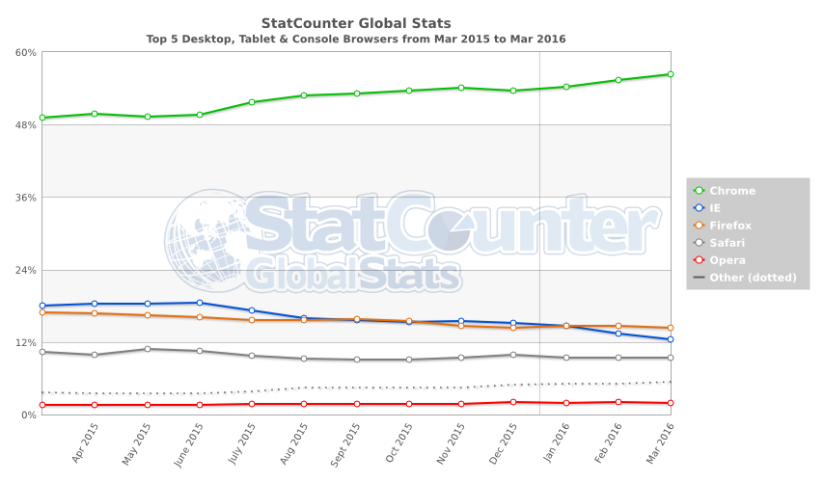
Browser usage (world, 15-16)
http://gs.statcounter.com/

Slide 7
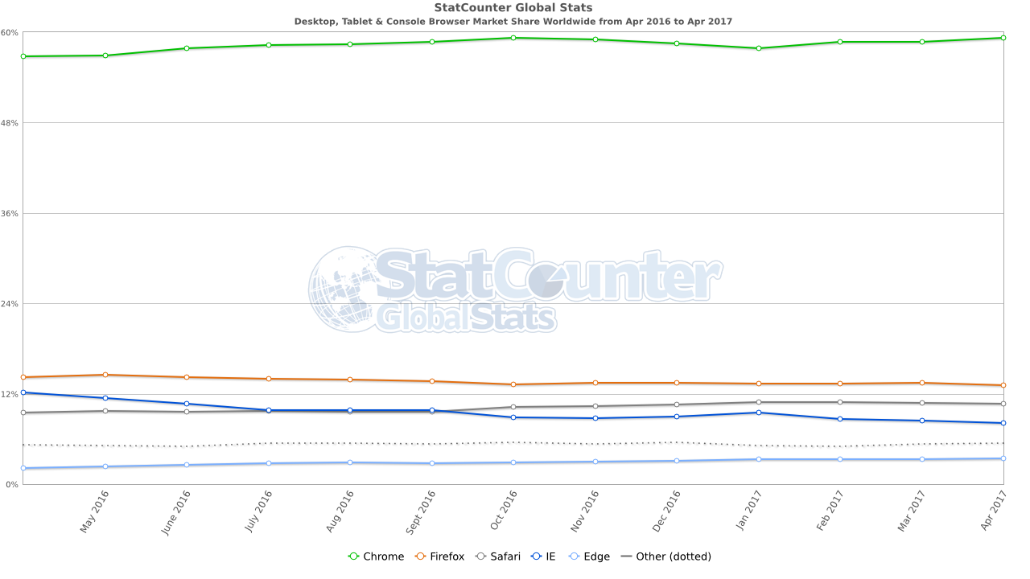
Browser usage (world, 16-17)
http://gs.statcounter.com/browser-market-share/desktop-tablet-console/worldwide/#monthly-201604-201704

Slide 8
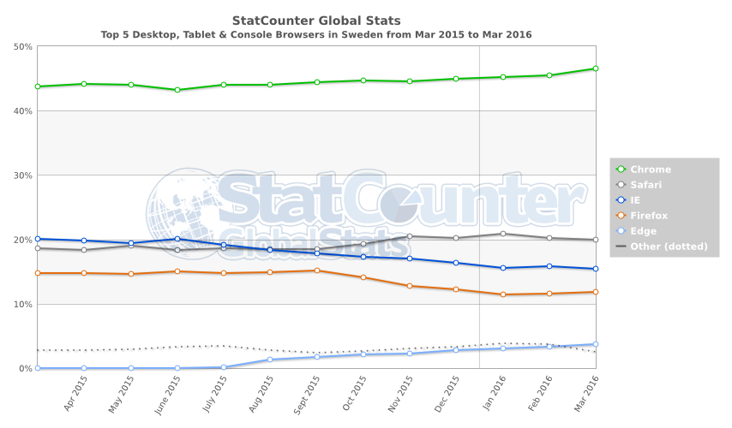
Browser usage (Sweden, 15-16)
http://gs.statcounter.com/#browser-SE-monthly-201503-201603

Slide 9
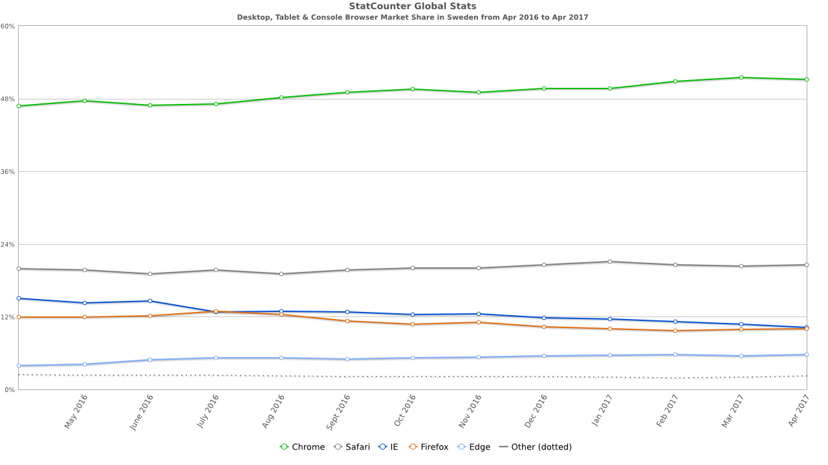
Browser usage (Sweden, 16-17)
http://gs.statcounter.com/browser-market-share/desktop-tablet-console/sweden/#monthly-201604-201704

Slide 10
Hello World
HTML 5 doctype.
<!DOCTYPE html>
<html>
<head>
<title>Hello World Example</title>
</head>
<body>
<h1>Hello World!</h1>
<p>Hello World in HTML.</p>
</body>
</html>
Meta data (data about the data)
Actual data

Slide 11
Some <head> elements
Tabs, bookmarks.
<title>Hogwarts</title>
<meta charset="UTF-8">
<meta name="author" content="Helga Hufflepuff">
<meta name="description" content="Hogwarts School of Witchcraft and Wizardry">
<meta name="keywords" content="magic,talk snake,quidditch">
Search engines!
Check it out: http://www.svt.se/svttext/web/pages/100.html

Slide 12
Some <body> elements
Most tags belong to one of the following groups:
Block elements:
<h1>
<p>
<div>
...
Inline elements:
<a>
<abbr>
<span>
...

Slide 13
Block VS inline
Block elements spans the entire row.
Inline elements spans as little as possible (surrounds the text).
Some text!
<h1>Some text!</h1>
<p>Some text.</p>
<p>Some text.</p>
Some text.
Some text.
<h1>Some text</h1><p>Some text.</p><p>Some text.</p>

Slide 14
Block VS inline
Block elements spans the entire row.
Inline elements spans as little as possible (surrounds the text).
<p> A b c
de f</p>
A b c de f
<p>This is a very long line of text.</p>
This is a very long line of text.

Slide 15
Block VS inline
Block elements spans the entire row.
Inline elements spans as little as possible (surrounds the text).
<h1>Some text</h1>
<p>
<strong>Note:</strong>
Some text.
</p>
<p>Some text.</p>
Some text!
Note: Some text.
Some text.

Slide 16
Block VS inline
How can they be nested?
Block elements can be used in block elements.
Inline elements can be used in block elements.
Inline elements can be used in inline elements.
Block elements can not be used in inline elements.
Additional restrictions apply.
Do not put paragraphs in paragraphs.
…

Slide 17
Hyper links
<a href="http://www.nintendo.se/wiiu/wiiu">Go there!</a>
Browser renders.
Go there!
User clicks.
GET /wiiu/wiiu HTTP/1.1
Host: www.nintendo.se
...
Browser sends a new request.

Slide 18
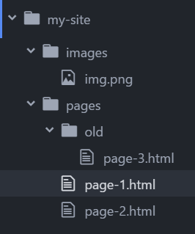
Relative paths
In file /my-site/pages/page-1.html:
page-2.html
→ /my-site/pages/page-2.html
old/page-3.html
→ /my-site/pages/old/page-3.html
../images/img.png
→ /my-site/images/img.png
../ can be written multiple times to go back multiple folders.

Slide 19
Forms
<form method="GET" action="http://www.mi6.com/login">
Username: <input type="text" name="un"><br>
Password: <input type="password" name="pw"><br>
<input type="submit" value="Login!">
</form>
Query string.
Browser renders.
GET /login?un=JamesBond&pw=missMP HTTP/1.1
Host: www.mi6.se
...
Username:
JamesBond
Password:
******
Login!
User submits.

Slide 20
The query string
Request can contain additional information in the query string.
/path/to/resource?THIS-IS-THE-QUERY-STRING
Query strings are written like this:
name1=value1
name1=value1&name2=value2
Reserved characters (; / ? : @ = &) and some special characters (space " < > # % { } | \ ^ ~ [ ] `) should be encoded.
= → %3D
& → %26
space → %20
# → %23

Slide 21
Forms
<form method="POST" action="http://www.mi6.com/login">
Username: <input type="text" name="un"><br>
Password: <input type="password" name="pw"><br>
<input type="submit" value="Login!">
</form>
Browser renders.
POST /login HTTP/1.1
Host: www.mi6.se
Content-Type: application/x-www-form-urlencoded
Content-Length: 22
...
un=JamesBond&pw=missMP
Username:
JamesBond
Password:
******
Login!
User submits.

Slide 22
Global attributes
Attributes any element can have.
https://developer.mozilla.org/en-US/docs/Web/HTML/Global_attributes
accesskey
Access to element through keyboard combination.
hidden
Hides elements (can later be shown with JavaScript).
lang
Specify the language the text is written in inside the element.
ISO Language Codes: http://www.w3schools.com/tags/ref_language_codes.asp
ISO Country Codes: http://www.w3schools.com/tags/ref_country_codes.asp

Slide 23
Global attributes
Attributes any element can have.
https://developer.mozilla.org/en-US/docs/Web/HTML/Global_attributes
title
Advisory information about the element.
class
Used to group similar elements together (used by CSS and JavaScript).
id
Used by CSS and JavaScript to uniquely identify an element.

Slide 24
Web Content Accessibility Guidelines
https://www.w3.org/WAI/intro/wcag
Quick reference:
https://www.w3.org/WAI/WCAG20/quickref

Slide 25
Structural elements
<header> - the header part in the page.
<main> - the main content in the page.
<footer> - the footer in the page.
<aside> - not the main content, but still relevant.
<nav> - navigation links.
<article> - to group the content of an article together.
<section> - group relevant content together.
<div> - to group elements together.
<div> is an old element, the others are new in HTML5.

Slide 26
Character entities
< and > denote tags.
What about smilies? :-< >.< >.>
&NAME; alternative representation.
&lt; → <
&gt; → >
What about &?
&amp; → &
https://www.w3.org/TR/html5/syntax.html#named-character-references

Slide 27
useful tools
https://jsfiddle.net
Write code online in a web browser.
See the result.
Share your code.
http://browsershots.org
Takes screenshots of your website in different browsers.
https://validator.w3.org
Validates your HTML code.

Slide 28
Recommended reading
Dive into HTML5 by Mark Pilgrim (funny to know)
Chapter 1, Introduction: Five Things You Should Know About HTML5
http://diveintohtml5.info/introduction.html
Chapter 2, A Quite Biased History of HTML5
http://diveintohtml5.info/past.html
Chapter 3, What does it all mean? (the section THE DOCTYPE only)
http://diveintohtml5.info/semantics.html
W3Sschools
HTML tutorial
https://www.w3schools.com/html/default.asp

Slide 29
Recommended reading
Mozilla's resources
HTML guide
https://developer.mozilla.org/en-US/docs/Web/Guide/HTML/Introduction
HTML documentation
https://developer.mozilla.org/en-US/docs/Web/HTML/Reference
W3's HTML specification:
https://www.w3.org/TR/html5/

